Slide 1
IST 718 - Final Project
Brian Taylor
Matthew Stockhaus
Sathish Rajendiran

Slide 2

COVID-19 Impact on the Real Estate Market
Summary of Findings:
COVID-19 has caused massive shocks to the housing market and additional factors contributing to home purchases. We observed record highs and lows across our data sets going back 4 to 24 years.
Recommendations:
If you can afford home at current MLP/Home Value, buy soon while Interest Rates are at 20-year low for 15YR and 30YR Fixed Mortgages
If you can sell your home, consider selling in this market while Median List Price and Home Values are at an all-time high, and Home Inventory is at lowest point in last 3 years and expected to continue to drop.

Slide 3
Specification
The Problem:
Due to COVID-19 changing social and professional constructs, people have been in a frenzy to buy homes (having saved money from inability to go outside or participate in events). From the news, online publications, and personal experiences, we can see that this has had a significant impact on the overall housing market, from both the buyers perspective and the sellers perspective.
Hypotheses:
Buyers who are financially capable of purchasing a home, will be more likely to get the lowest interest rates for next few years than those who do not purchase now.
However, buyers will experience highest home prices and severe supply & demand shock due to COVID-19.
Sellers who can sell their home between March 2020 – EOY 2021 will be more likely to retrieve the highest home sale price for the next few years than those who do not sell now.
Data:
Zillow Data (Home Inventory, Median List Price, Home Value Index)
FRED Data (Emp. to Pop. Ratio, Unemp. Rate, 15YR/30YR Mortgage Rate Average – all 2001 – 2021)
Opendatasoft Data (Latitude and Longitude by US Zip Code)

Slide 4
Observation
Based on data used, we can conclude that COVID-19 has impacted the housing market by:
Home Inventories have reached their lowest point in the last 3 years
Home Median List Prices have reached their highest point in the last 3 years
Home Values have reached their highest point in the last 24 years
Employment to Population Ratio reached lowest point in the last 20 years
Unemployment Rate reached highest point in the last 20 years
15YR and 30YR Fixed Mortgage Rates reached lowest point in 20 years

Slide 5
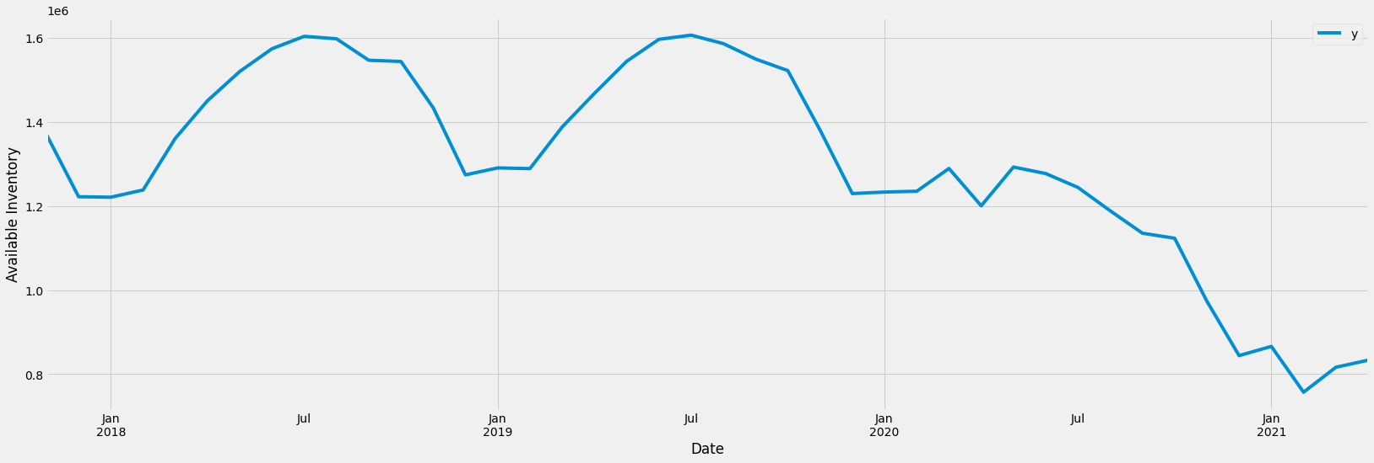
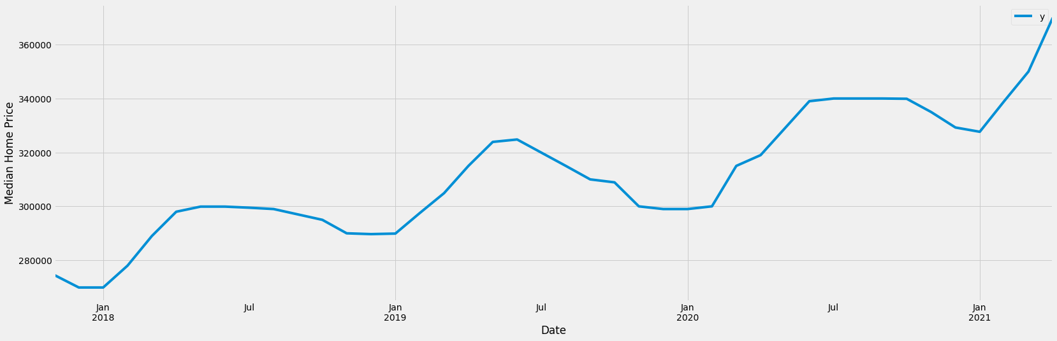
Exploratory Analysis – Zillow Data
Available Inventory (U.S.) 2017 - 2021
Median Home List Price (U.S.) 2017 - 2021

Slide 6
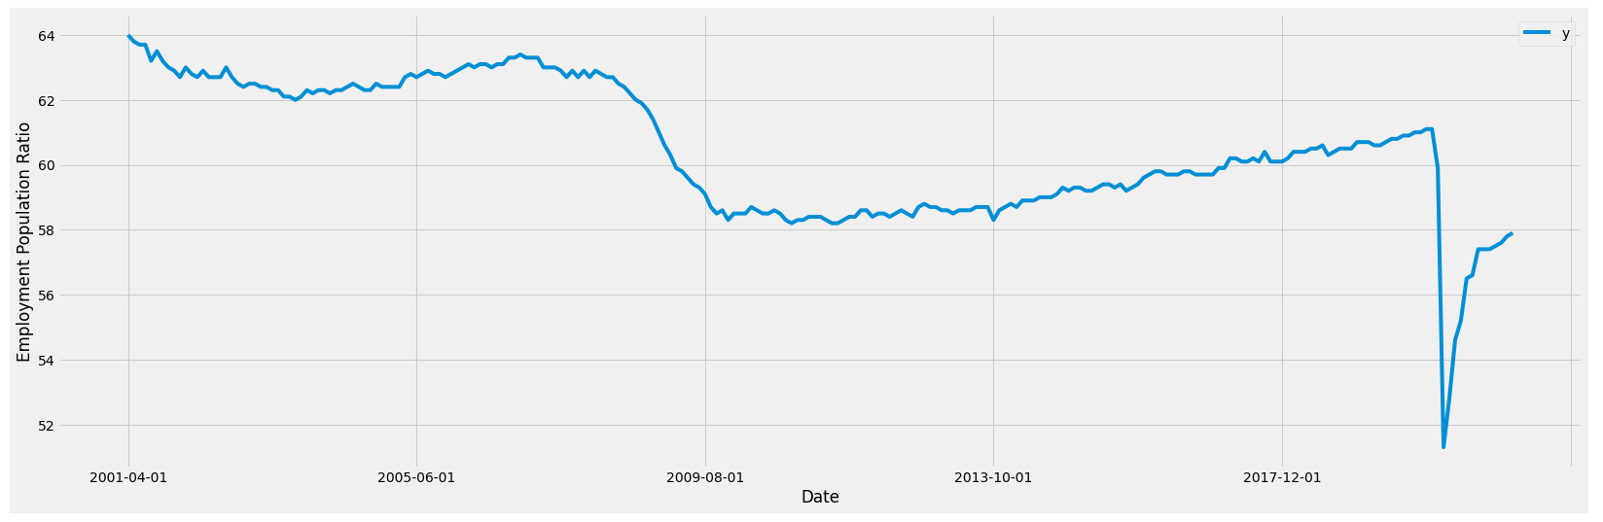
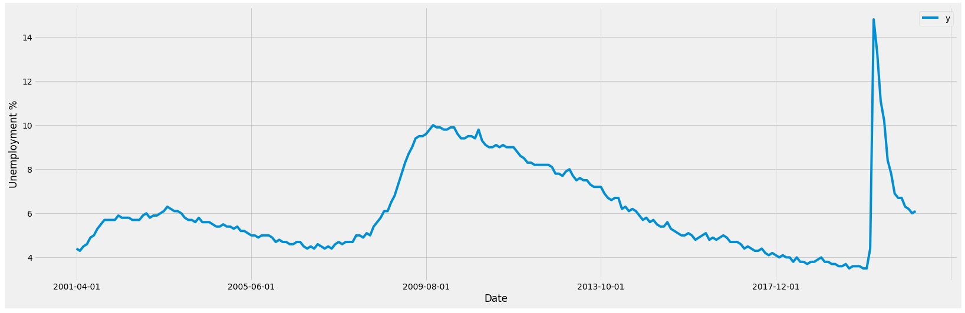
Exploratory Analysis – FRED Data
Employment to Population Ratio 2001 - 2021
Unemployment Rate 2001 - 2021

Slide 7
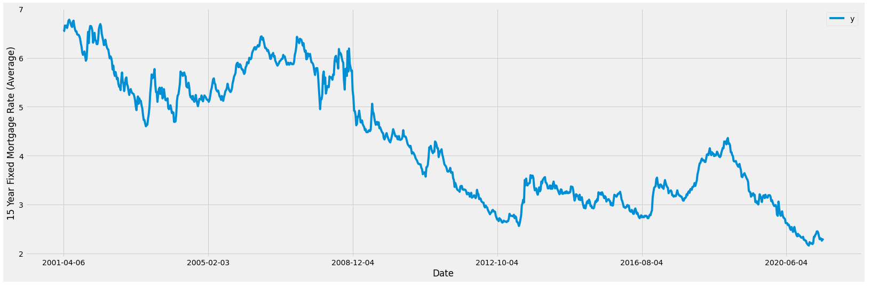
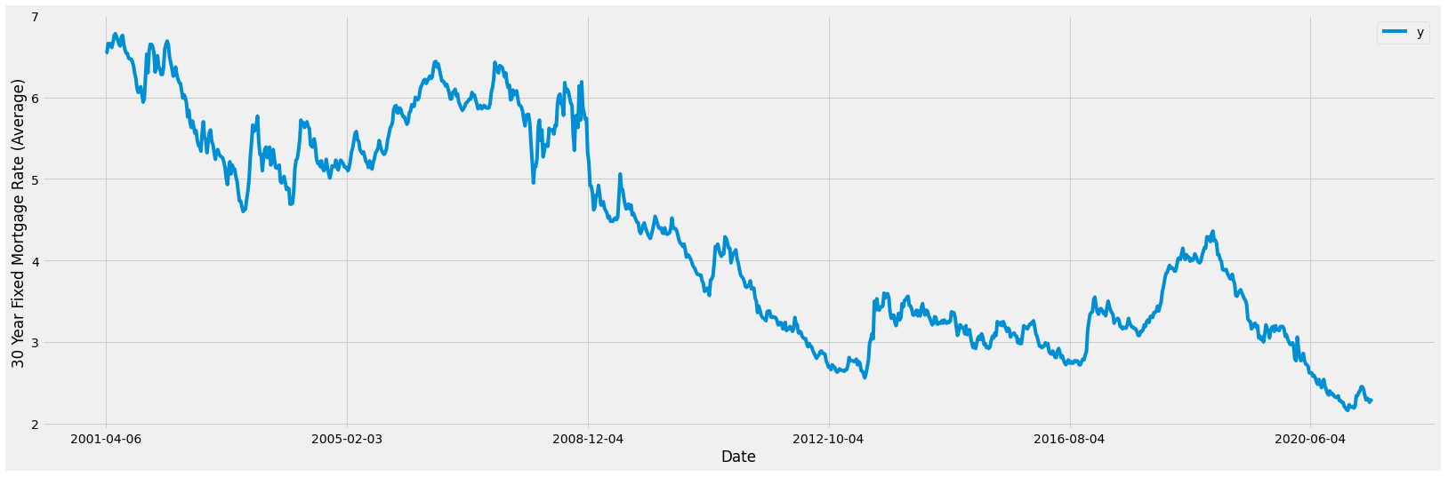
Exploratory Analysis – FRED Data
15YR Fixed Mortgage Rate Average 2001 - 2021
30YR Fixed Mortgage Rate Average 2001 - 2021

Slide 8
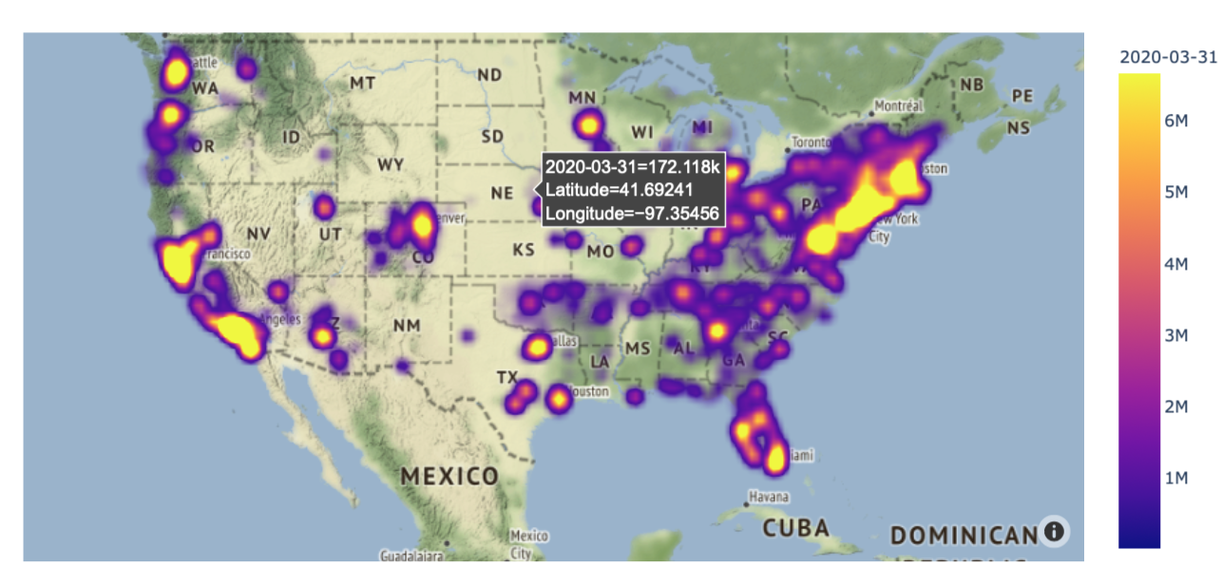
Interactive Map Visualization

Slide 9
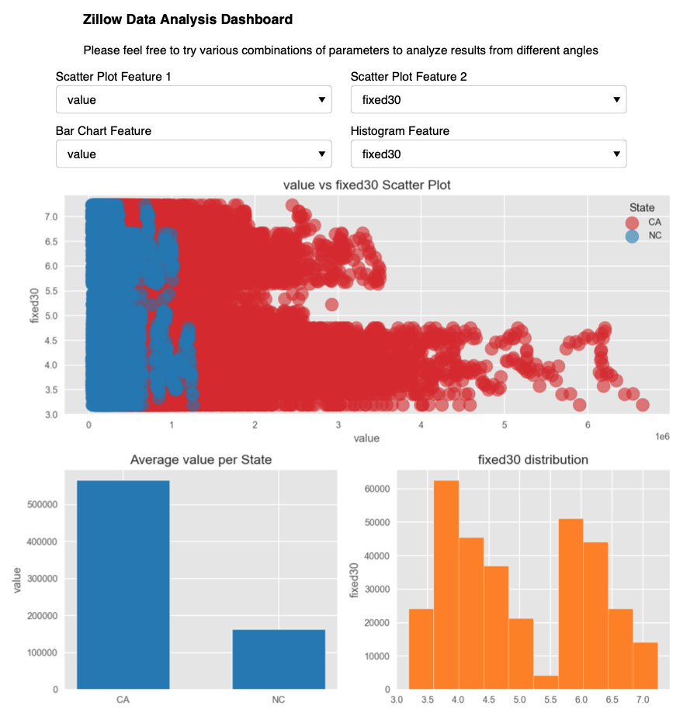
Interactive Dashboard
http://localhost:54182
Notes:
heading = "<h3>Zillow Data Analysis Dashboard</h3>\nPlease feel free to try various combinations of parameters to analyze results from different angles"
text = pnw.StaticText(value=heading, align="center")
dash3 = pn.Column(
text,
pn.Row(f1,f2, align="center"),
pn.Row(f3,f4, align="center"),
pn.Row(create_dash)
)
dash3

Slide 10
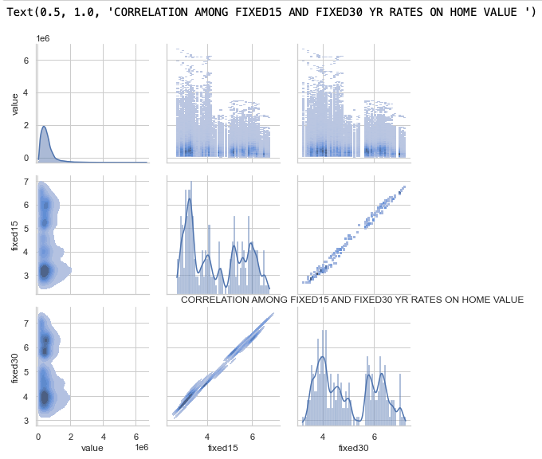
Correlation Graph

Slide 11
Advance Analysis - Machine Learning Models
Modeling techniques used:
Autocorrelation, Partial Autocorrelation
SARIMAX models focusing on CA, NC, and VA
Auto ARIMA & Grid Search Framework
Prophet (Entire U.S.)
Notes:
Auto-Regressive (p) -> Number of autoregressive terms.
Integrated (d) -> Number of non seasonal differences needed for stationarity.
Moving Average (q) -> Number of lagged forecast errors in the prediction equation.
In the Auto ARIMA model, note that small p,d,q values represent non-seasonal (Trend) components, and capital P, D, Q represent seasonal components

Slide 12
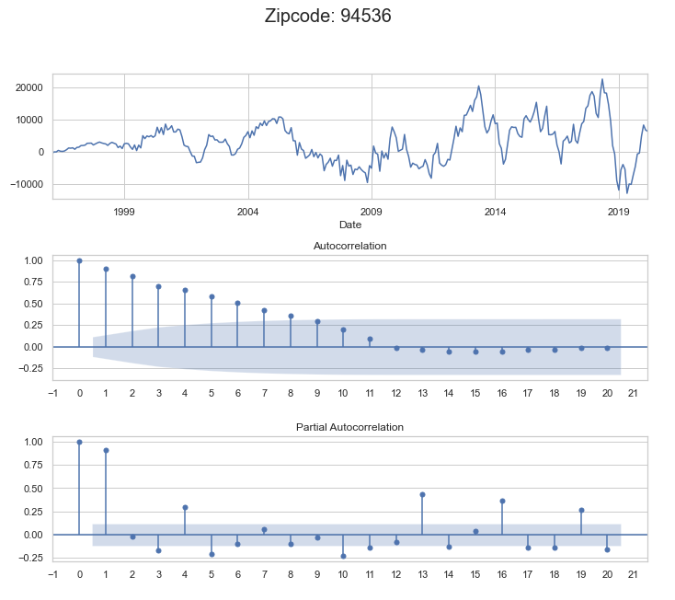
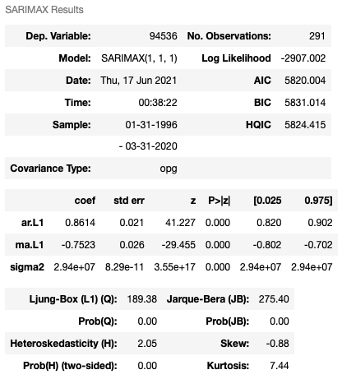
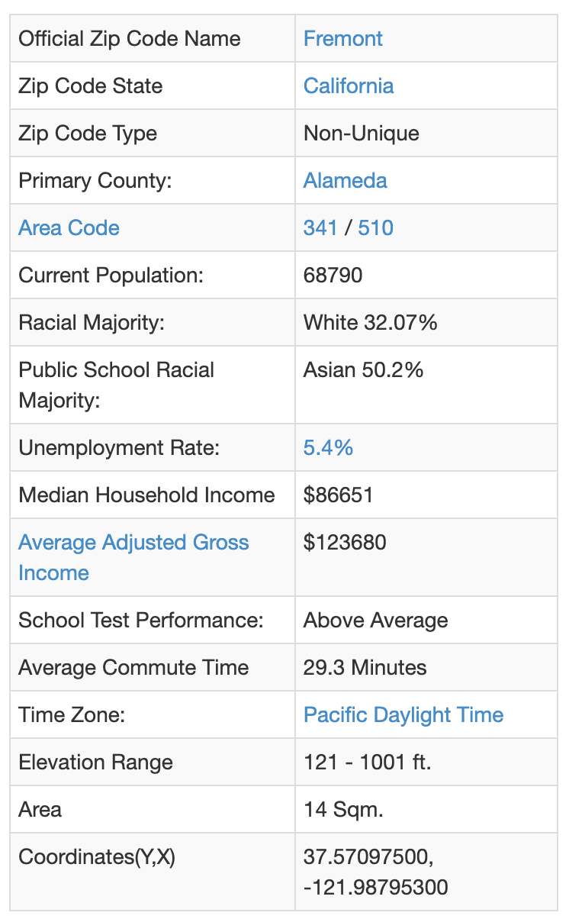
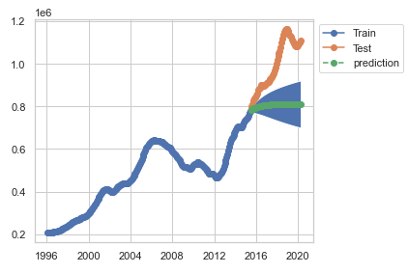
SARIMAX Results – Fremont, California
Notes:
best_model = SARIMAX(ts,order=auto_model.order,
seasonal_order=auto_model.seasonal_order).fit()
display(best_model.summary())
best_model.plot_diagnostics();

Slide 13
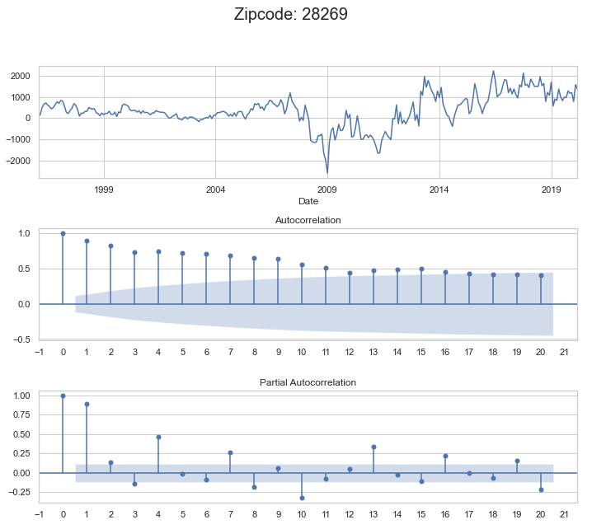
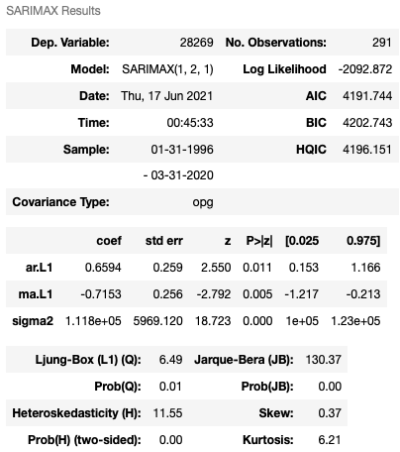
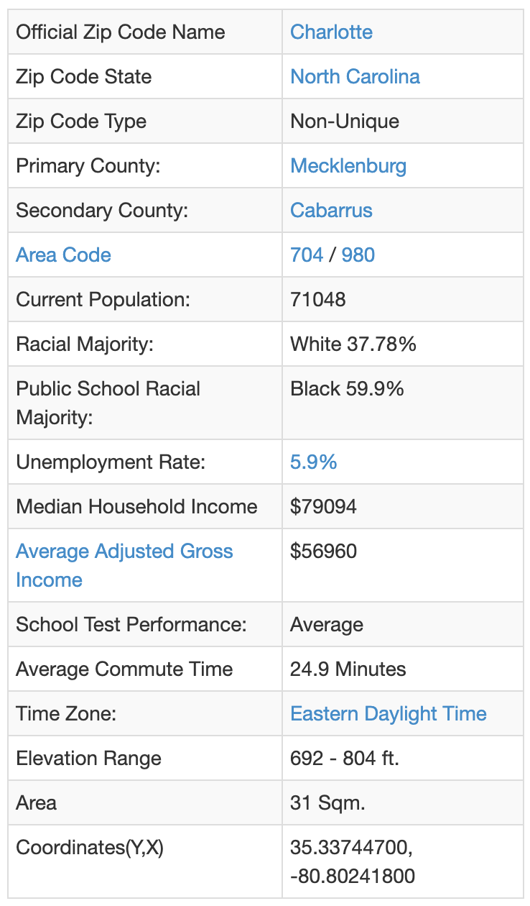
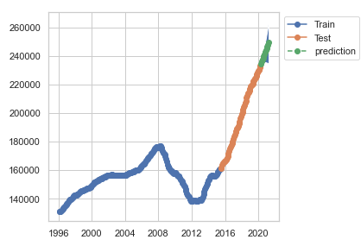
SARIMAX Results – Charlotte, North Carolina

Slide 14
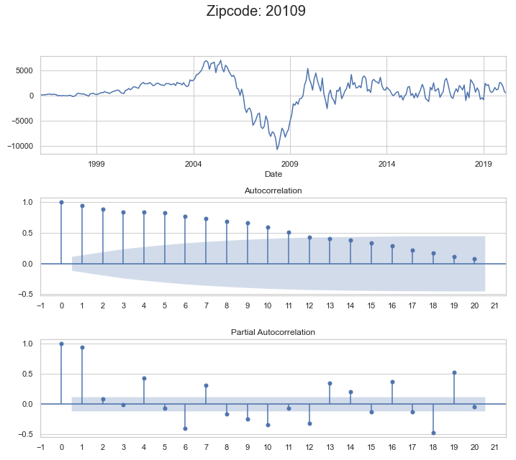
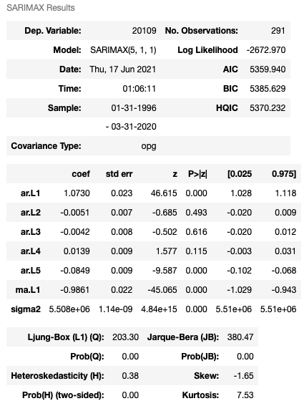
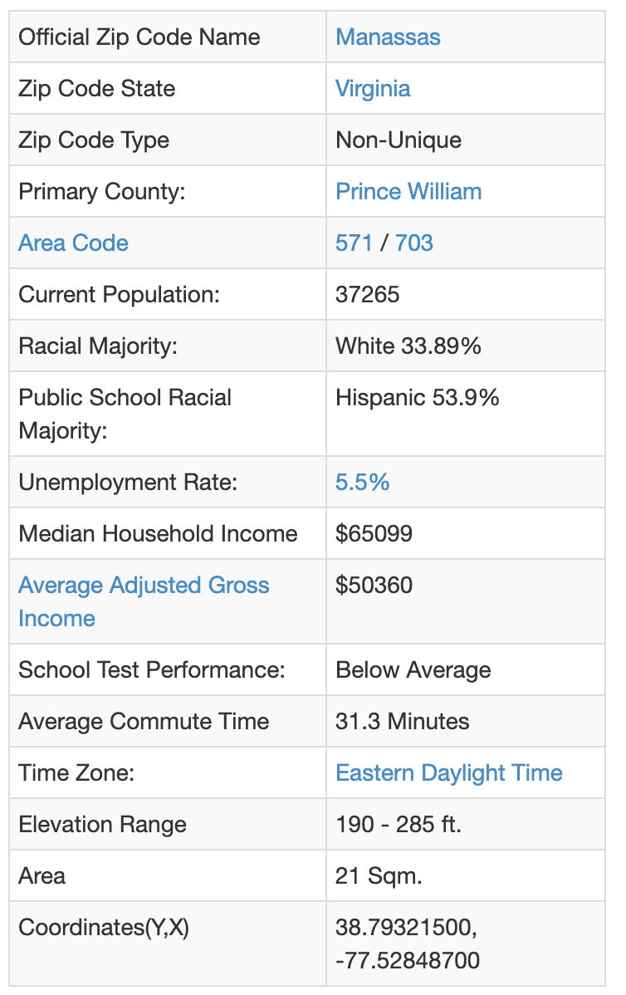
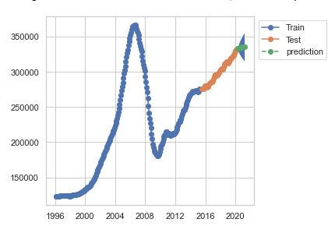
SARIMAX Results – Manassas, Virginia

Slide 15
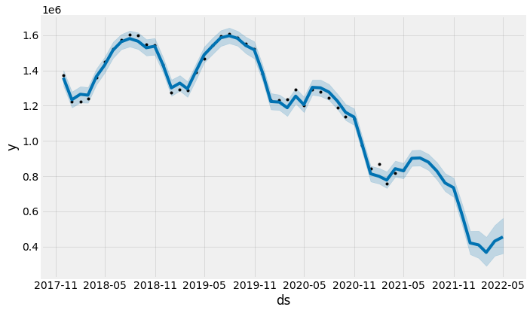
Prophet Model, U.S. Inventory
Inventory is expected to continue to decline until an expected to slightly rebound about February 2022.

Slide 16
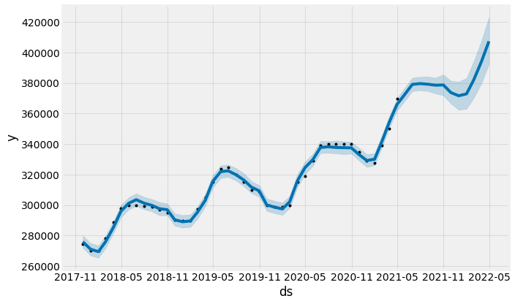
Prophet Model, U.S. Median Home List Price
Based on the prediction, the rest of 2021 appears to have plateaued.
A brief decline in the median home price is expected around February 2022.

Slide 17
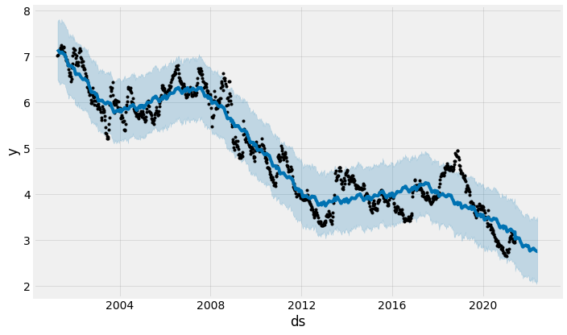
Prophet Model, 30-year Interest Rates
Interest rates are projected to continue to decline for a 30-year fixed rate loan.

Slide 18
Recommendation & Next Steps
Based on our observation and analysis, we would recommend the following:
Should buyers purchase now?
If you can afford home at current MLP/Home Value, buy soon while Interest Rates are at 20-year low for 15YR and 30YR Fixed Mortgages
Should sellers list now?
If you can sell your home, consider selling in this market while Median List Price and Home Values are at an all-time high, and Home Inventory is at lowest point in last 3 years and expected to continue to drop.
If we could include additional data or conduct additional analysis:
New build/construction home data - impact on home inventory / supply & demand
Stock prices - 401k / liquidation for down payment
Leverage different modeling techniques

Slide 19
References
https://www.zillow.com/research/data/
https://fred.stlouisfed.org/series/MORTGAGE15US
https://fred.stlouisfed.org/series/MORTGAGE30US
https://fred.stlouisfed.org/series/UNRATE
https://fred.stlouisfed.org/series/EMRATIO
https://public.opendatasoft.com/explore/dataset/us-zip-code-latitude-and-longitude/export/
https://colab.research.google.com/notebooks/pro.ipynb#scrollTo=23TOba33L4qf
https://www.unitedstateszipcodes.org/94536/
https://towardsdatascience.com/heatmap-basics-with-pythons-seaborn-fb92ea280a6c
https://towardsdatascience.com/14-data-visualization-plots-of-seaborn-14a7bdd16cd7
https://coderzcolumn.com/tutorials/data-science/how-to-create-dashboard-using-python-matplotlib-panel
https://machinelearningmastery.com/how-to-grid-search-sarima-model-hyperparameters-for-time-series-forecasting-in-python/
https://towardsdatascience.com/time-series-forecasting-using-auto-arima-in-python-bb83e49210cd

Slide 20
Thank you

